Slide 1
Predicting Loan Credit Risk

Slide 2
Contents
Introduction
Tools Used
Implementation
Results Evaluation
Conclusion

Slide 3
Introduction
Machine Learning is been part of everyday life of human beings
Without knowing them, suppose if we look at YouTube videos, they analyse our data and sends us the videos which we cannot skip watching them.
Not only YouTube it’s been used many top companies like Google, Microsoft, Apple and many others.
In our project we are going to predict bank loan credit risk using Apache sparks ml Random Forests and Decision trees.

Slide 4
Tools
Spark Machine Learning
Classification Algorithms---> Random Forests and Decision Tree.
IntelliJ.

Slide 5
Decision Tree
A decision tree is a supervised machine learning classification algorithm that uses a tree like model of decisions and their possible outcomes.
For better understanding we can ask the first question like if checking account balance is greater than 200 and then two more questions can be derived like duration of credit greater then 29 months for partial creditability and length of employment greater than 9 months for partial non-creditability.

Slide 6
Random Forests
Random forests are the best classification algorithm out of all classification algorithms and it gives the more accuracy compared to other algorithms.
This algorithm is a popular ensemble learning method for both classification and regression.
This model consists of multiple decision trees depending on different subsets of data at the training stage.

Slide 7
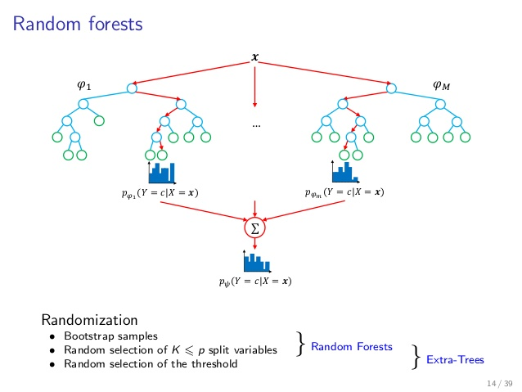
Contin.....

Slide 8
Dataset
The dataset consists of 20 attributes and a total of 1000 instances or records. Attributes include both categorical and integer values.
Below are the features of the data.
Features → {"balance", "duration", "history", "purpose", "amount", "savings", "employment", "instPercent", "sexMarried", "guarantors", "residenceDuration", "assets", "age", "concCredit", "apartment", "credits", "occupation", "dependents", "hasPhone", "foreign"}

Slide 9
Analysis of data
Input data from the csv file is read as RDD and it is parsed and then converted to data frame which makes life easier to analyse.
Also, we have used SparkSQL for pranalysis of data which shows the complete description about the column like mean, max and min values of that column.
Finally, we have applied Machine learning models to predict whether the bank customer is credit worthy or not to give a loan.
Lectures used are Spark RDD, Spark Data Frames, SparkSQL and Spark Machine Learning.

Slide 10
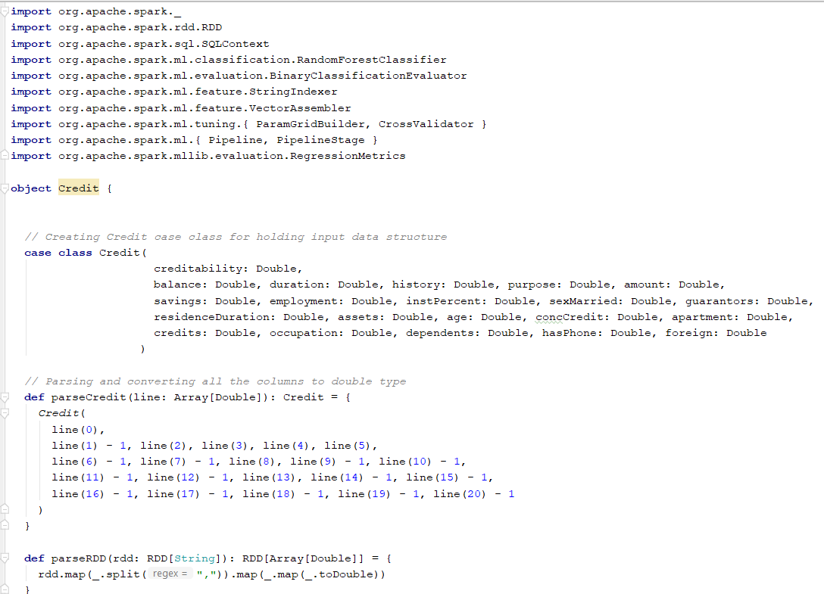
Implementation
Random Forest Code

Slide 11
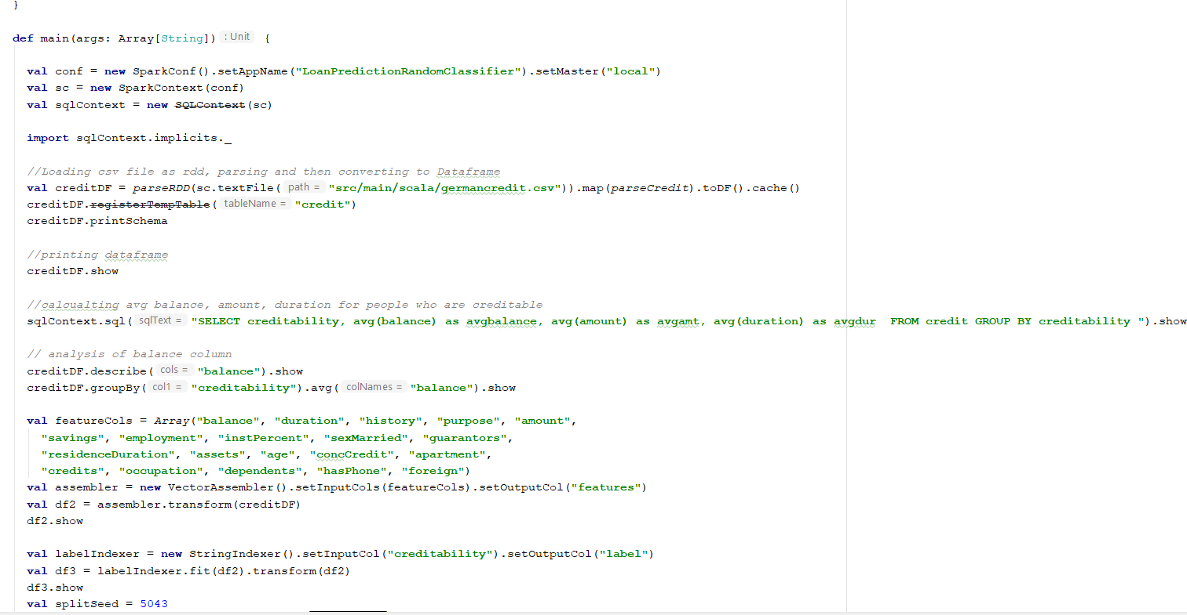

Slide 12
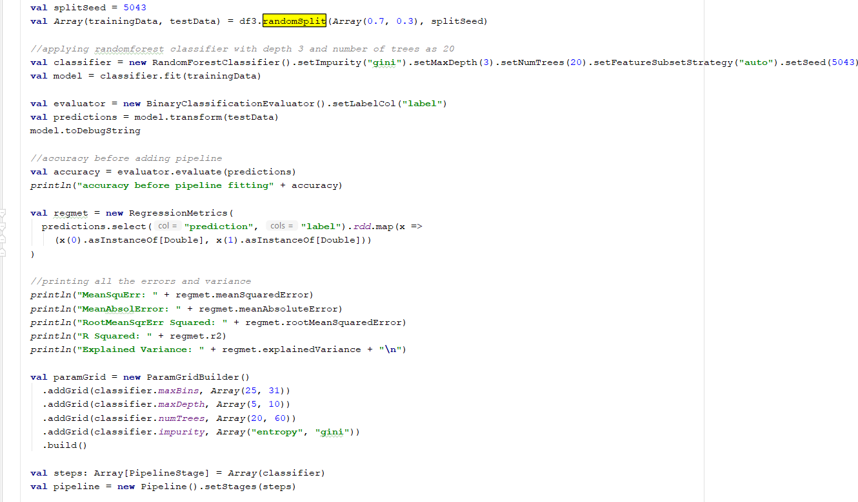

Slide 13
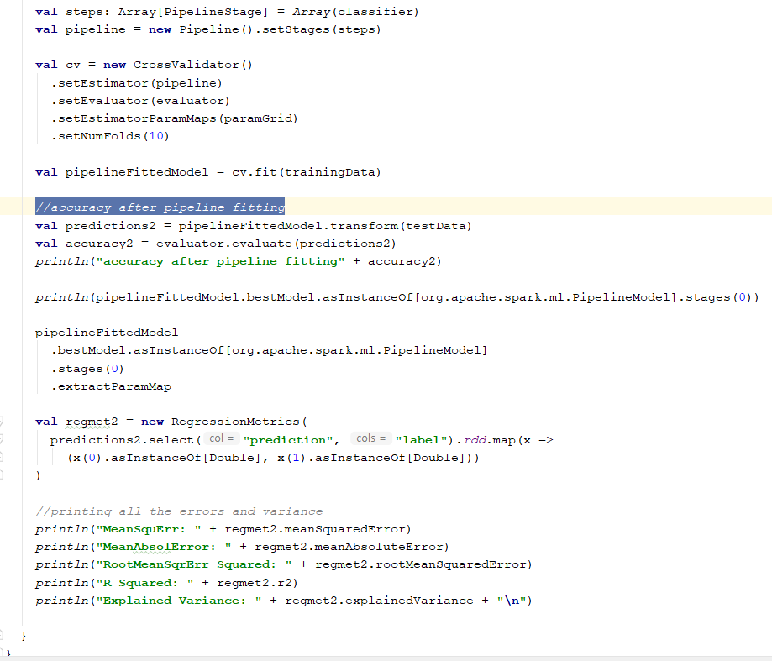

Slide 14
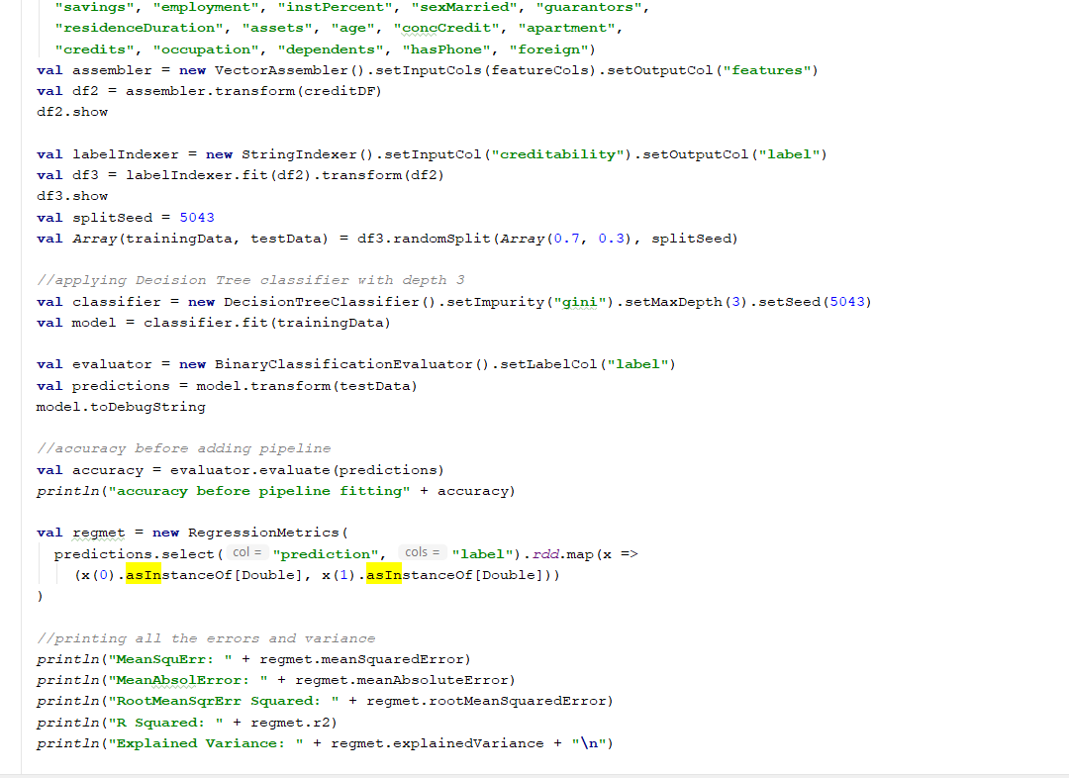
Decision Tree Code

Slide 15
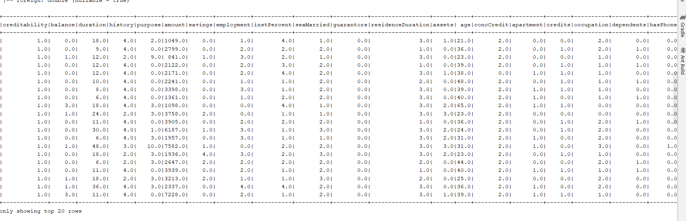
Results
Random Forest Output

Slide 16
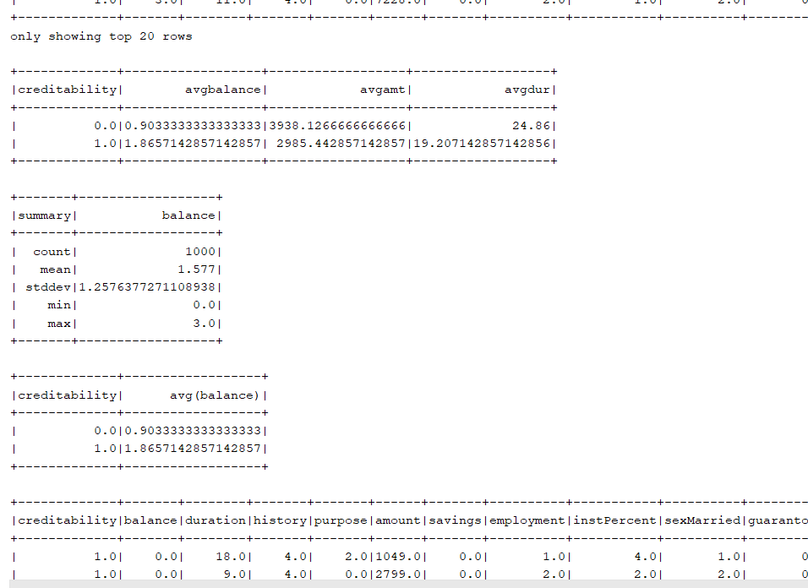

Slide 17
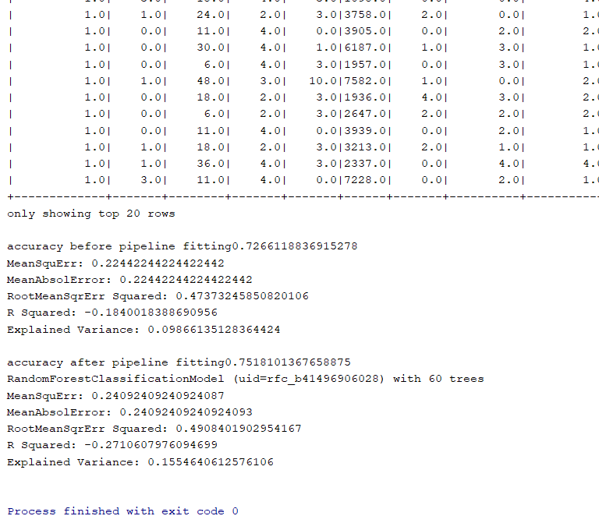

Slide 18
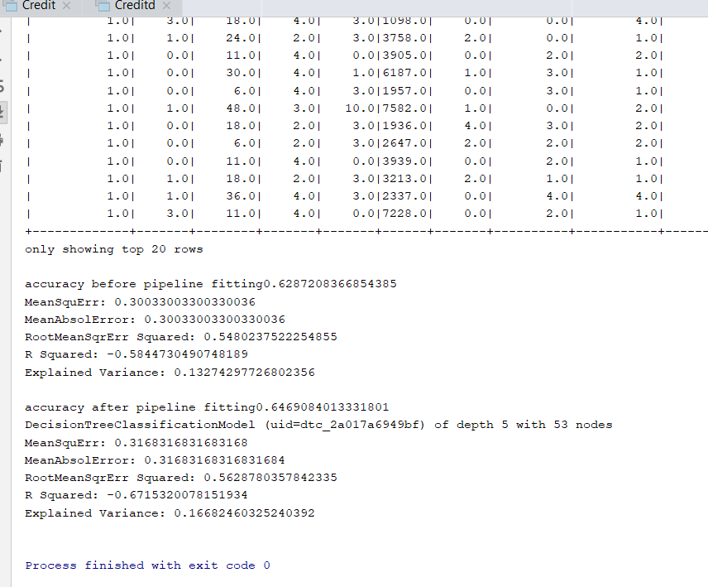
Decision Tree Output

Slide 19
Conclusion
In conclusion Random Forest gives better results than the Decision tree.
Also, by using ML Pipeline gives higher accuracy percentage than without the ML Pipeline. A pipeline gives a basic method to experiment with various mixes of parameters, utilizing a procedure called network look, where you set up the parameters to test, and MLLib will test every one of the mixes.
Pipelines make it simple to tune a whole model building work process without a moment's delay, instead of tuning every component in the Pipeline independently.

